Slide 1

PowerPoint to accompany
Introduction to MATLAB for Engineers
Third Edition
William J. Palm III
Chapter 11
MuPAD
Copyright © 2010. The McGraw-Hill Companies, Inc. This work is only for non-profit use by instructors in courses for which this textbook has been adopted. Any other use without publisher’s consent is unlawful.

Slide 2
What can you do with MuPAD?
■ Create symbolic expressions and manipulate them algebraically.
■ Obtain symbolic and numeric solutions to algebraic and transcendental
equations.
■ Perform symbolic linear algebra operations, including obtaining expressions for determinants, matrix inverses, eigenvectors, and eigenvalues.
■ Perform symbolic differentiation and integration.
■ Evaluate limits and series symbolically.
■ Obtain symbolic solutions to ordinary differential equations.
■ Obtain and apply Laplace transforms.
■ Solve ordinary differential equations in terms of special functions or series.
11-2

Slide 3
To start MuPAD, first start MATLAB, then type mupadwelcome.
You will then see the Welcome Screen shown on the next slide.
If you just type mupad instead, you will immediately be presented with a blank notebook .
11-3

Slide 4
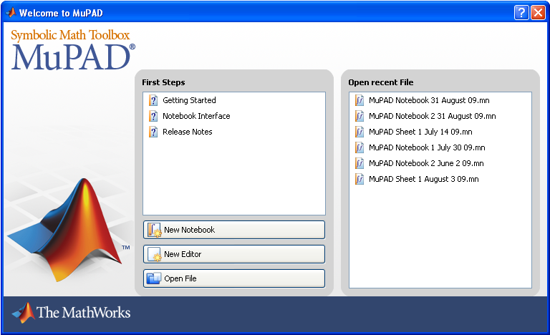
The MuPAD welcome screen. Figure 11.1-1 on page 467
11-4

Slide 5
If you then click on Getting Started, you will see what is on the next slide.
Or you can click on Notebook Interface to bring up the Notebook Interface Help screen shown on slide 11-7.
Or you can retrieve a previously created notebook by clicking on its name under Open Recent File.
11-5

Slide 6
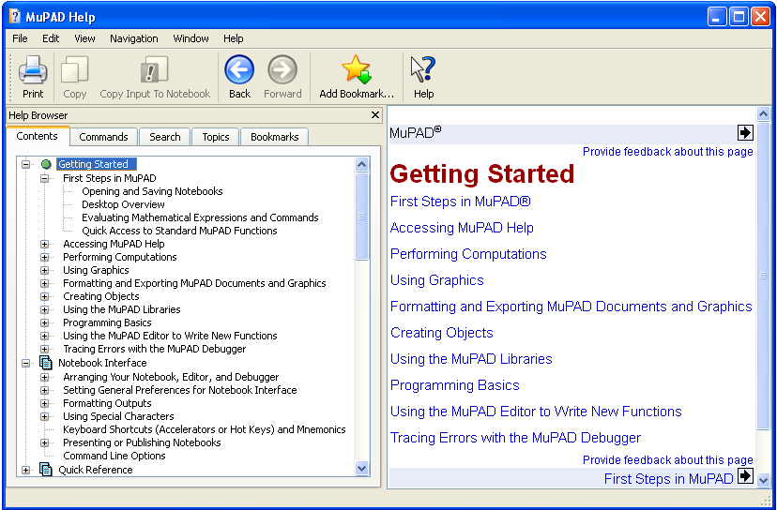
The Getting Started screen. Figure 11.1-2 on page 467.
11-6

Slide 7
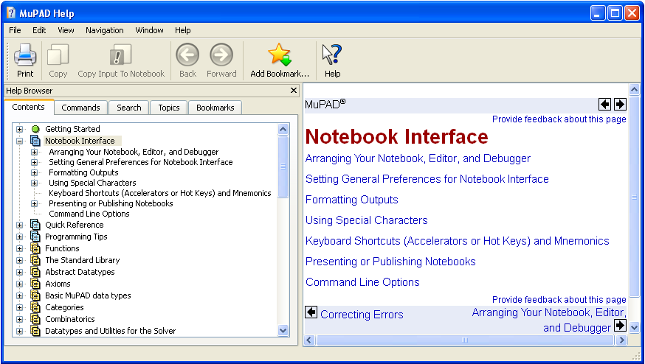
The Notebook Interface Help screen. Figure 11.1-3 on page 468.
11-7

Slide 8
The Notebook Interface shown on the next slide shows text, input, and output regions, with the code required to create a plot.
11-8

Slide 9
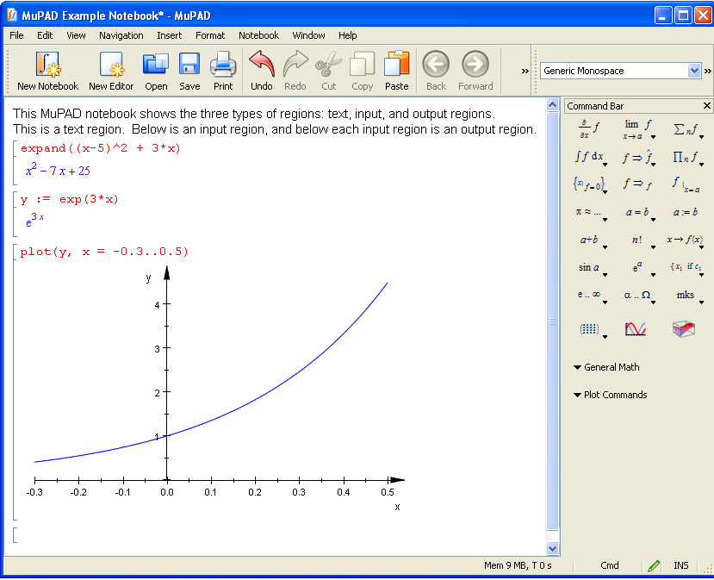
An example of the Notebook Interface. Figure 11.2-1 on page 473.
11-9

Slide 10
The Standard toolbar. Figure 11.1-5 on page 469.
11-10

Slide 11
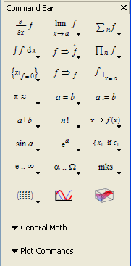
The Command bar. Figure 11.2-2 on page 474.
11-11

Slide 12
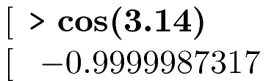
Entering Commands (page 470).
11-12

Slide 13
The General Math Menu. Page 475.
The General Math Menu
Expand Simplify
Factor Combine
Normalize Rewrite
Evaluate Solve
11-13

Slide 14
Table 11.2–1 Items on the Command bar. Page 475.
Derivatives Limits Sums
Integrals Rewrite Expressions Products
Solve Equations Simplify Evaluate with x = a
Numerical Evaluation and Rounding Equality Tests Assignment
Math Operators Factorials Function Definition
Trig Functions Exponentials and Logs Piecewise Definitions
Reserved Symbols Greek Letters Physical Units
Matrices and Vectors 2D Plot 3D Plot
11-14

Slide 15
The Simplify Menu. Page 476.
General Exponential
Logical Logarithm
Radical Sine
Relational Cosine
11-15

Slide 16
The Combine Menu. Page 477.
General Power
Arc Tangent Sine/Cosine
Exponential Sine/Cosine Hyp
Logarithm Square Root
11-16

Slide 17
The Rewrite Menu. Page 478.
Differential Heaviside
Exponential Logarithm
Factorial Sign
Gamma Sine/Cosine
11-17

Slide 18
The Solve Menu. Page 481.
Exact Polynomial Diophantine Equation
Numeric Recurrences
Linear System ODE
11-18

Slide 19
Table 11.8–1 Special function calls in MuPAD. Page 512.
Name and Symbol Function Call
Airy, Ai(x) airy Ai(x)
Airy, Bi(x) airy Bi(x)
Chebyshev of first kind, T(n, x) chebyshev1 (n, x)
Gamma, (x) gamma(x)
Hermite, Hn(x) hermite (n,x)
Bessel I, In(x) besselI(n,x)
Bessel J, Jn(x) besselJ(n,x)
Bessel K, Kn(x) besselK(n,x)
Bessel Y, Yn(x) besselY (n,x)
Laguerre, L(n, a, x) laguerreL(n,a,x)
Legendre, Pn(x) legendre(n,x)
11-19

Slide 20
Table 11.8–2 Evaluation of special functions in MuPAD
Result Code
Symbolic finite series orthpoly::
Symbolic infinite series series
Numeric result float
11-20

Slide 21
The following slides are figures from the examples and the homework problems.
11-21

Slide 22
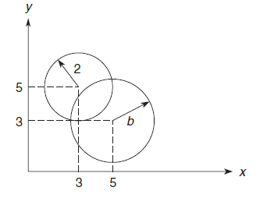
Figure 11.3-1 for Example 11.3-1 on page 484. Intersection points of two circles.
11-22

Slide 23
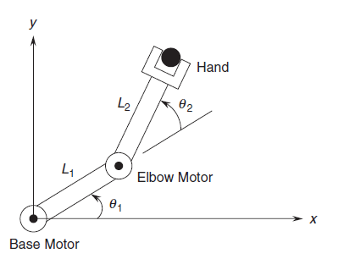
Figure 11.3-2 for Example 11.3-2 on page 486. A robot arm having two joints and two links.
11-23

Slide 24
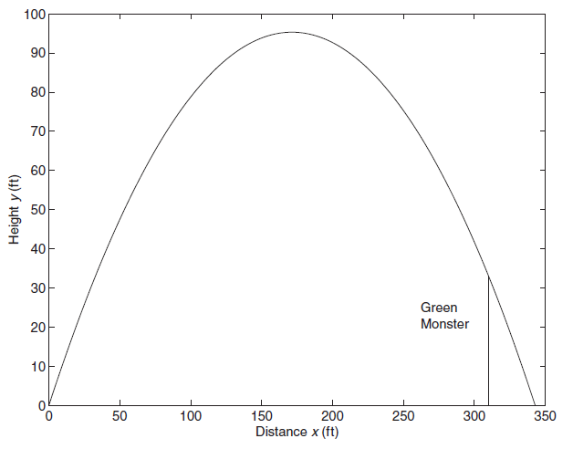
Figure 11.5-1 for Example 11.5-1 on pages 495-497. A baseball trajectory to clear the Green Monster.
11-24

Slide 25
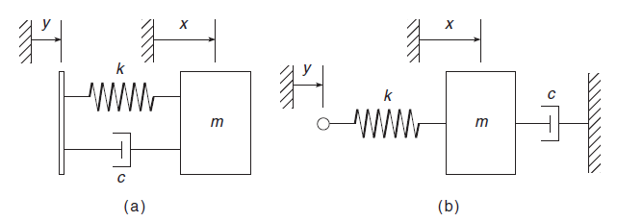
Figure 11.7-1 on page 510. Two mechanical systems, one with and one without an input derivative.
11-25

Slide 26
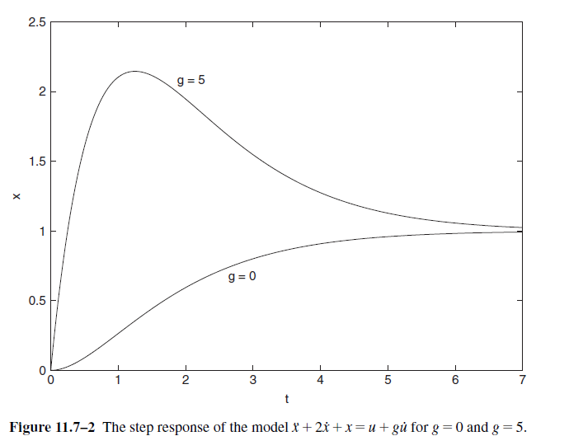
Figure 11.7-2 on page 511.
11-26

Slide 27
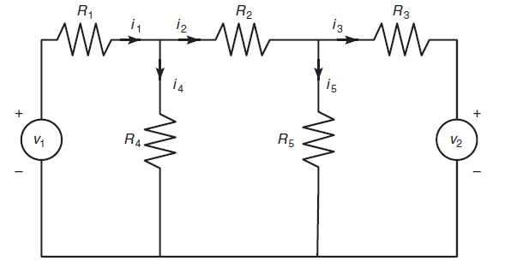
Figure P12 for Problem 12 on pages 516-517.
11-27

Slide 28
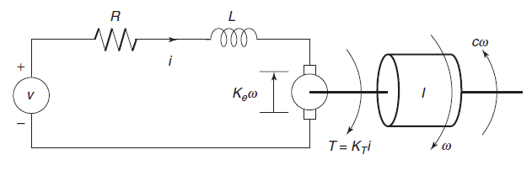
Figure P13 for Problem 13 on pages 517-518.
11-28

Slide 29
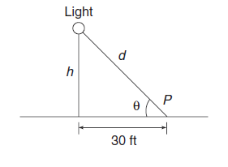
Figure P13 for Problem 13 on page 519.
11-29

Slide 30
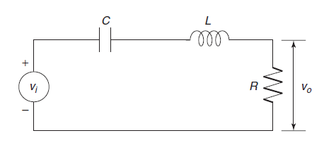
Figure P28 for Problem 28 on page 520.
11-30

Slide 31
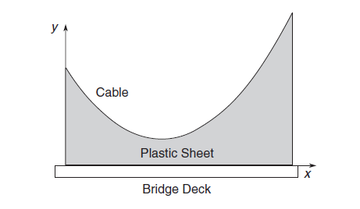
Figure P29 for Problem 29 on pages 520-521.
11-31

